Slide 1
4 BIT Vedic Multiplier
VLSI Lab-EC403
Under the supervison of
Dr .Vasantha MH
Presented by
SAHIL YADAV [20ECE1039]
RAUSHAN KUMAR [20ECE1042]
DEPARTMENT OF ELECTRONICS AND COMMUNICATION ENGINEERING
17 ^{nd} November 2024

Slide 2
AIM
The main aim of this project is to design and simulation of Low power, High Performance Full adder and half adder circuit and measure different parameters 4-bit multiplier and Low-Power¸ High Performance a) 4 bit Vedic Multiplier and 4 bit multiplier using Cadence tool
Considering their advantages and disadvantage these are compares on the basis of area, speed and delay

Slide 3
What is an Multiplier ?
Multiplication is a mathematical operation that at its simplest is an abbreviated process of adding an integer a specified of times.
Carries out arithmetic and logic operations on the Operands in computer .
What is Propagation Delay ?
The average of time taken for output to change from low level to high level and high level to low level.
Tp = (TpHL + TpLH) / 2

Slide 4
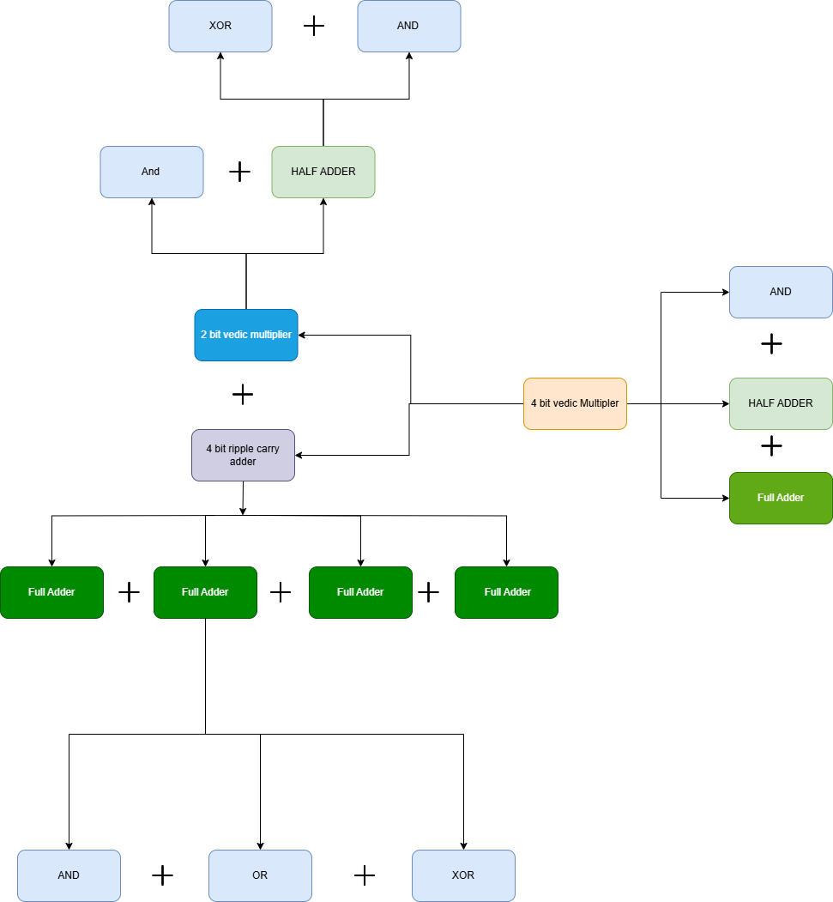
Our Approach ..?

Slide 5
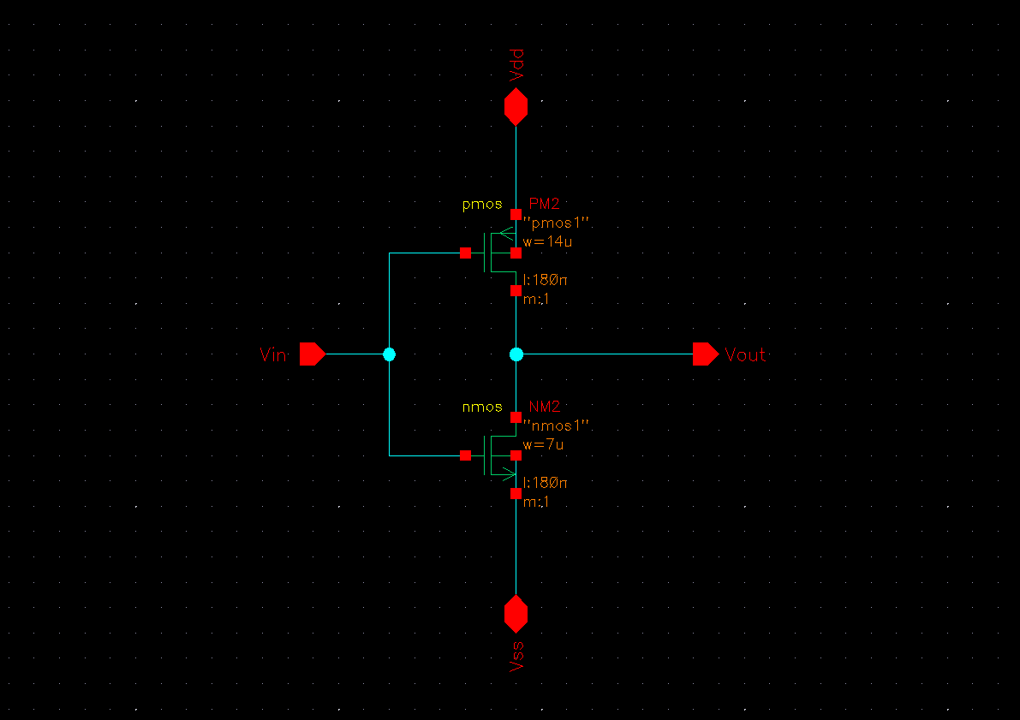
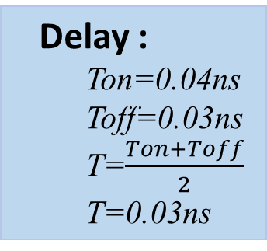
Inverter:
Y=A’
A | Y
0 | 1
1 | 0
Delay :
Ton=0.04ns
Toff=0.03ns
T=$\frac{Ton+Toff}{2}$
T=0.03ns
Transistors:
2 mosfets
Fig-1 : Schematic of Inverter

Slide 6
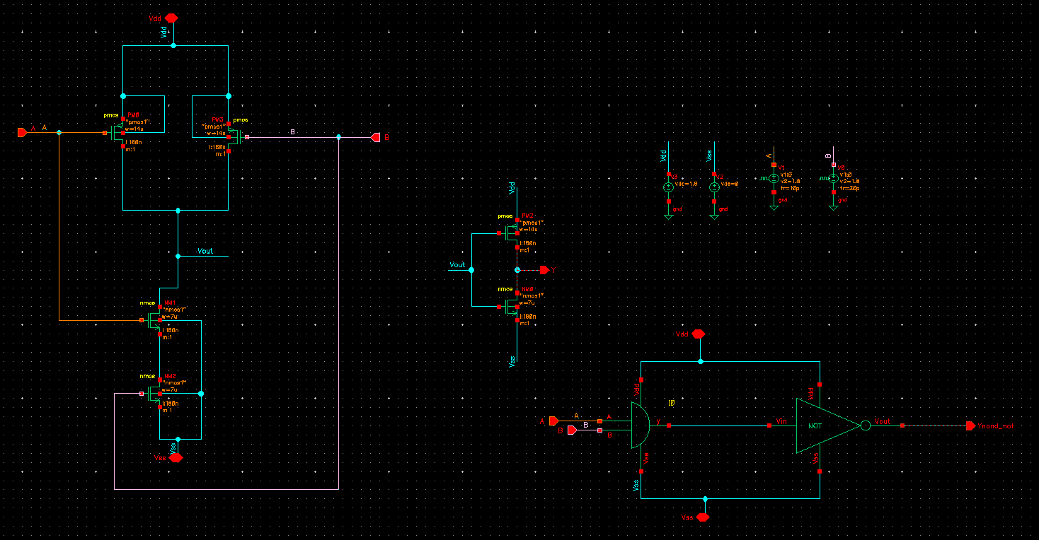
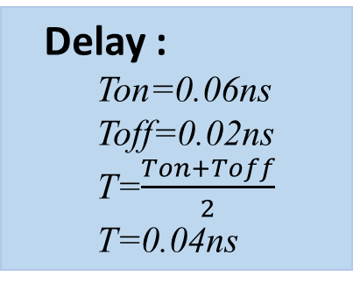
NAND:
Y=(A.B)’
A | B | C
0 | 0 | 1
0 | 1 | 1
1 | 0 | 1
1 | 1 | 0
Delay :
Ton=0.06ns
Toff=0.02ns
T=$\frac{Ton+Toff}{2}$
T=0.04ns
Transistors:
4 mosfets
Fig-2 : Schematic of NAND

Slide 7
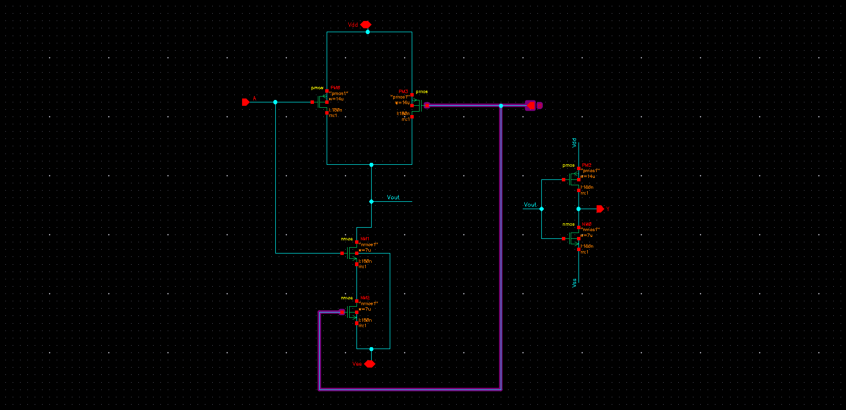
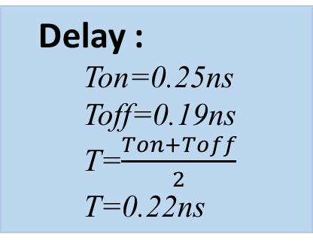
AND:
Y=A.B
A | B | C
0 | 0 | 0
0 | 1 | 0
1 | 0 | 0
1 | 1 | 1
Delay :
Ton=0.25ns
Toff=0.19ns
T=$\frac{Ton+Toff}{2}$
T=0.22ns
Transistors:
6 mosfets
Fig-4 : Schematic of AND

Slide 8
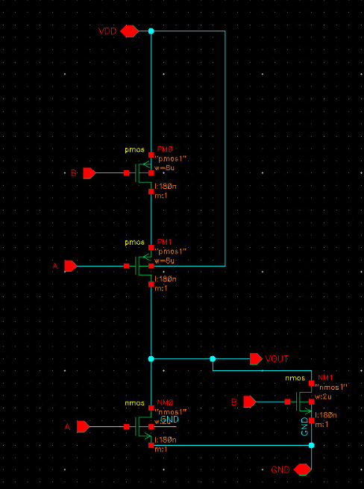
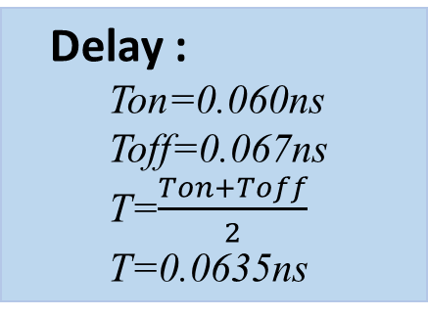
NOR:
Y=(A+B)’
A | B | C
0 | 0 | 1
0 | 1 | 0
1 | 0 | 0
1 | 1 | 0
Delay :
Ton=0.060ns
Toff=0.067ns
T=$\frac{Ton+Toff}{2}$
T=0.0635ns
Transistors:
4 mosfets
Fig-3 : Schematic of NOR

Slide 9
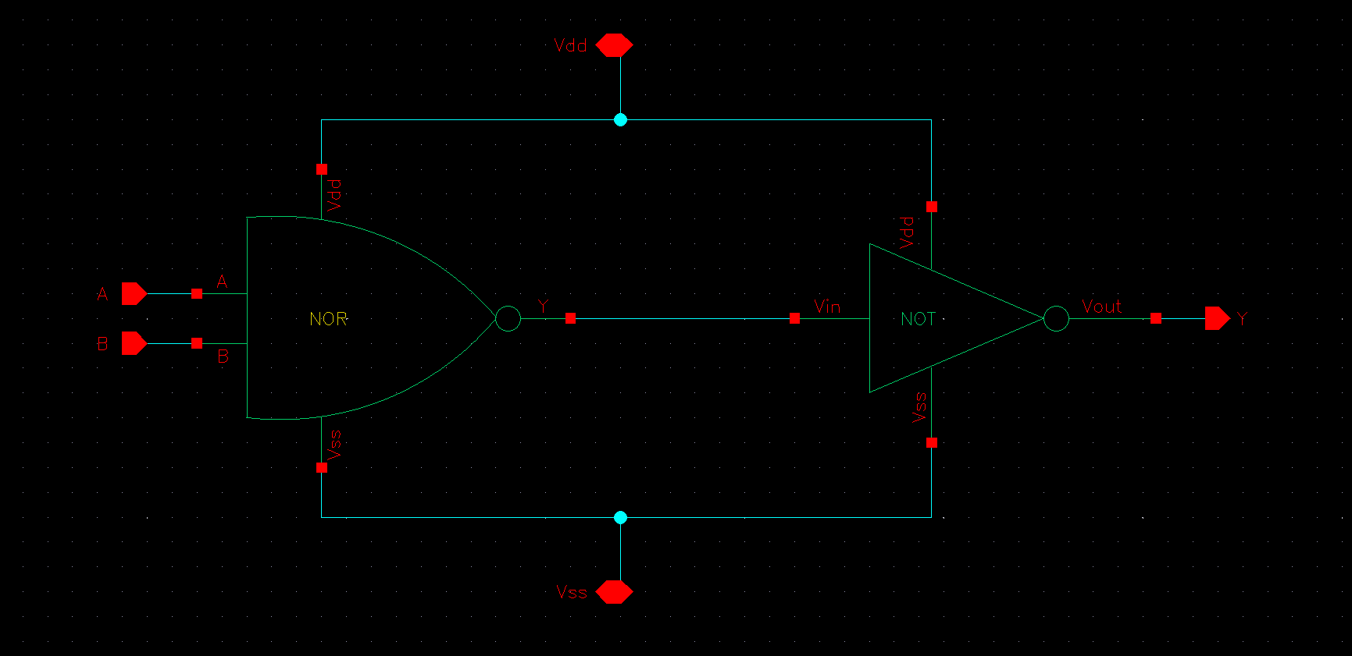
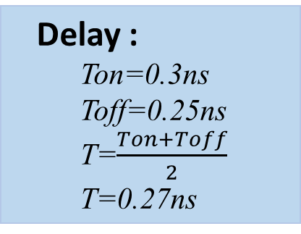
OR:
Y=A+B
A | B | C
0 | 0 | 1
0 | 1 | 1
1 | 0 | 1
1 | 1 | 0
Delay :
Ton=0.3ns
Toff=0.25ns
T=$\frac{Ton+Toff}{2}$
T=0.27ns
Transistors:
6 mosfets
Fig-5 : Schematic of OR

Slide 10
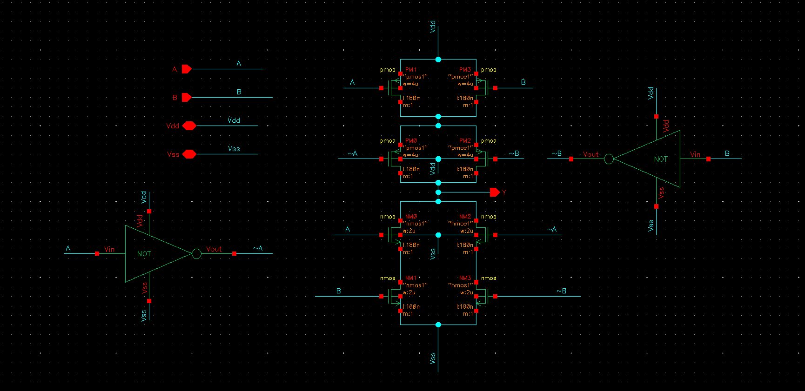
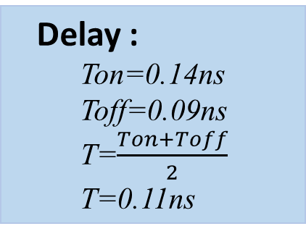
XOR:
Y=A’B + AB’
A | B | C
0 | 0 | 0
0 | 1 | 1
1 | 0 | 1
1 | 1 | 0
Delay :
Ton=0.14ns
Toff=0.09ns
T=$\frac{Ton+Toff}{2}$
T=0.11ns
Transistors:
12 mosfets
Fig-6 : Schematic of XOR

Slide 11
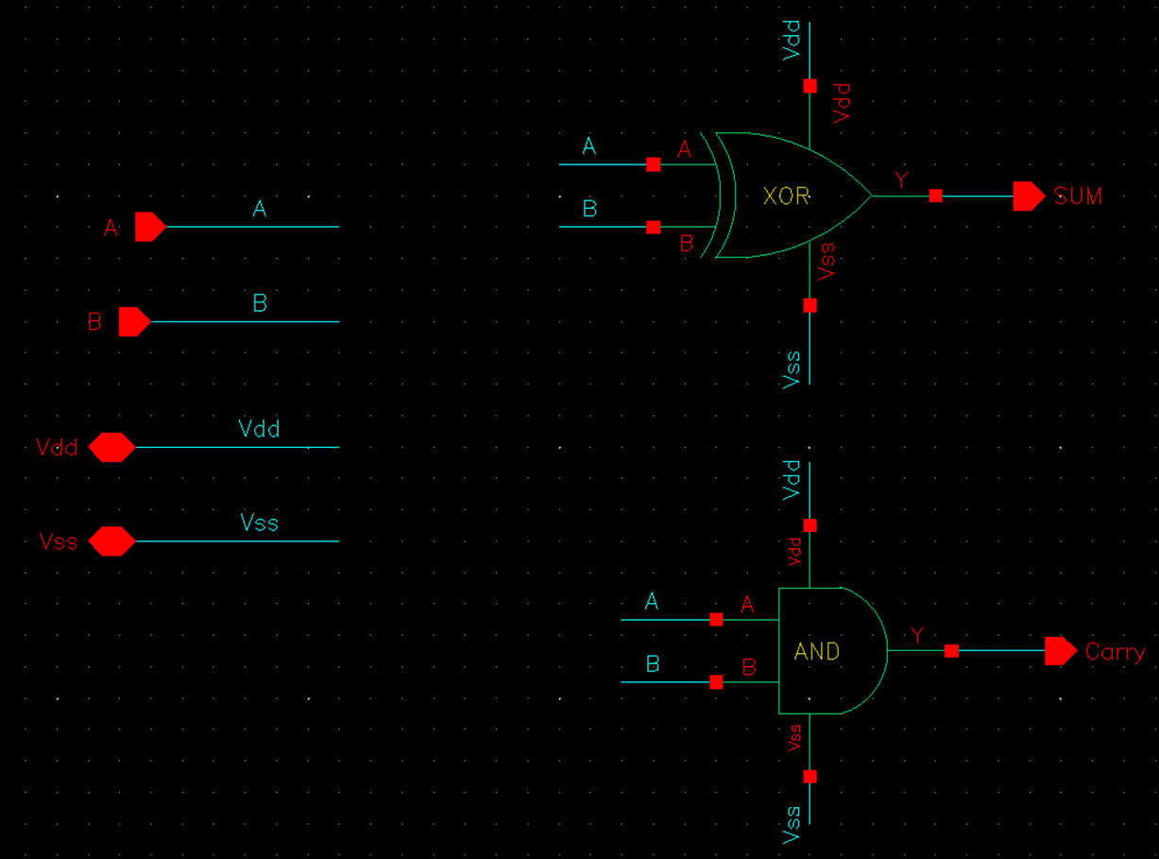
Half-Adder
Sum= A⊕B
Carry= A*B
A | B | Sum | Carry
0 | 0 | 0 | 0
0 | 1 | 1 | 0
1 | 0 | 1 | 0
1 | 1 | 0 | 1
Transistors:
20 mosfets
Fig-9 : Schematic of Half Adder

Slide 12
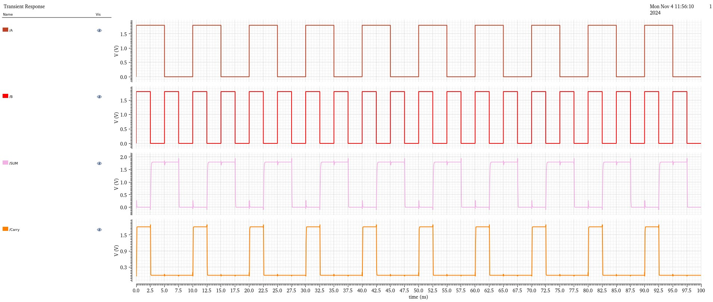
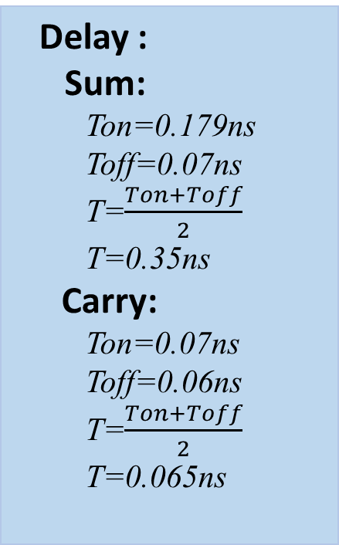
Output For Half- Adder:
Delay :
Sum:
Ton=0.179ns
Toff=0.07ns
T=$\frac{Ton+Toff}{2}$
T=0.35ns
Carry:
Ton=0.07ns
Toff=0.06ns
T=$\frac{Ton+Toff}{2}$
T=0.065ns
Fig-10 : Output of Half-Adder

Slide 13
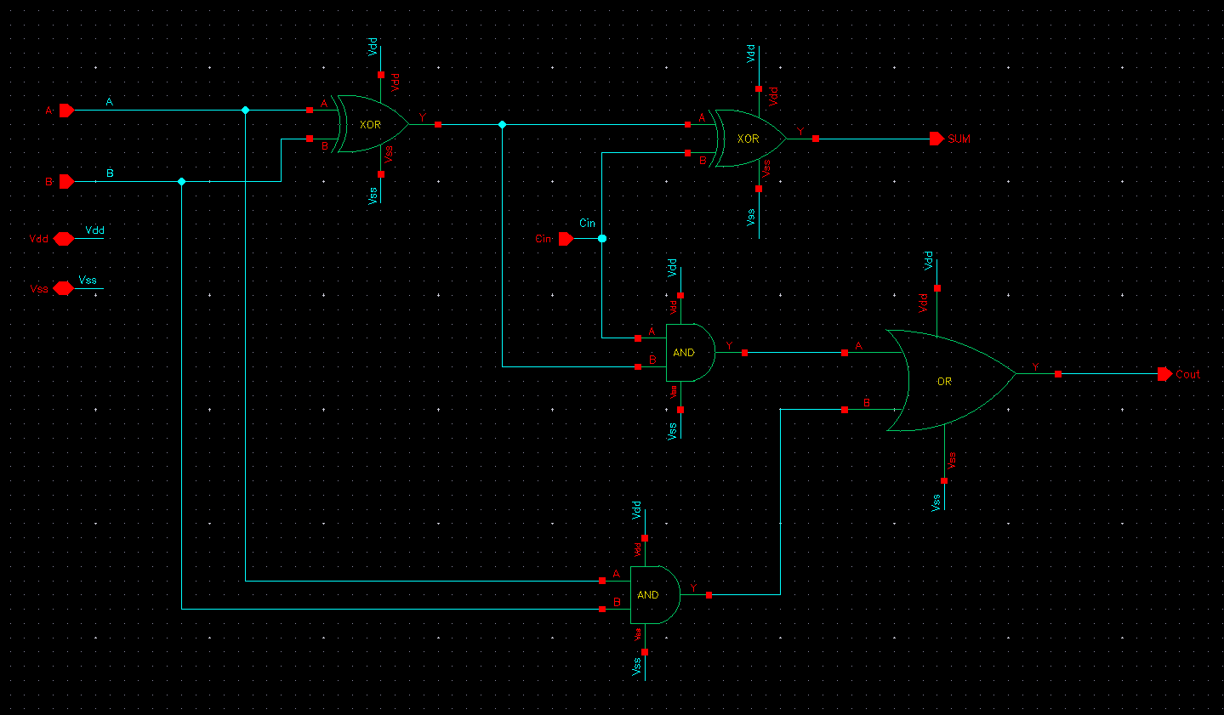
Full Adder
S = A ⊕B⊕Cin;
Cout = (A*B) + (Cin*(A⊕B)).
A | B | C | S | C0
0 | 0 | 0 | 0 | 0
0 | 0 | 1 | 1 | 0
0 | 1 | 0 | 1 | 0
0 | 1 | 1 | 0 | 1
1 | 0 | 0 | 1 | 0
1 | 0 | 1 | 0 | 1
1 | 1 | 0 | 0 | 1
1 | 1 | 1 | 1 | 1
Transistors:
48 mosfets
Fig-11 : Schematic of Full Adder

Slide 14
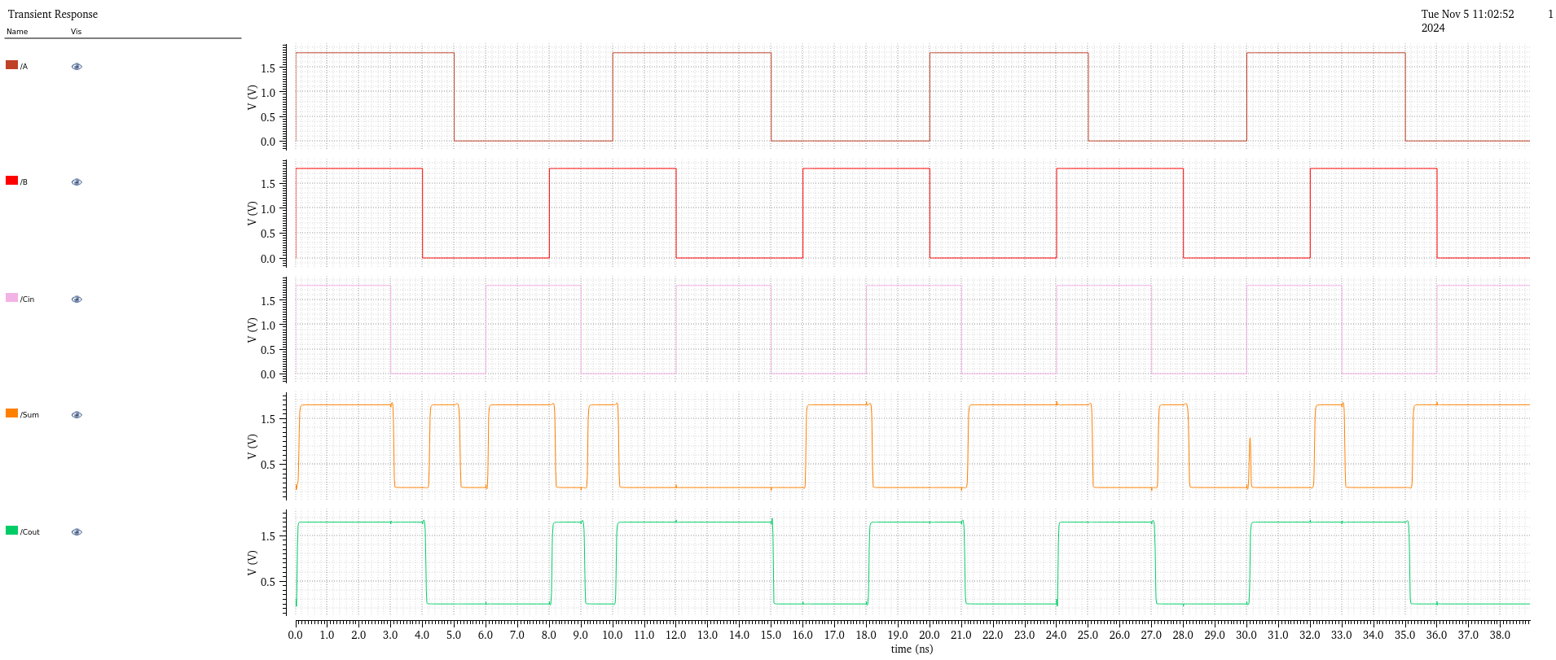
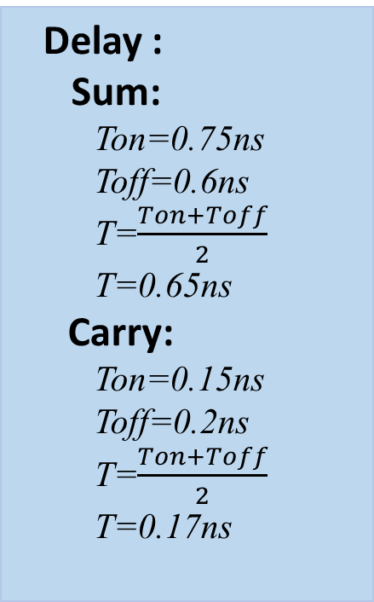
Output For Full Adder:
Delay :
Sum:
Ton=0.75ns
Toff=0.6ns
T=$\frac{Ton+Toff}{2}$
T=0.65ns
Carry:
Ton=0.15ns
Toff=0.2ns
T=$\frac{Ton+Toff}{2}$
T=0.17ns
Fig-12 : Output of Full Adder

Slide 15
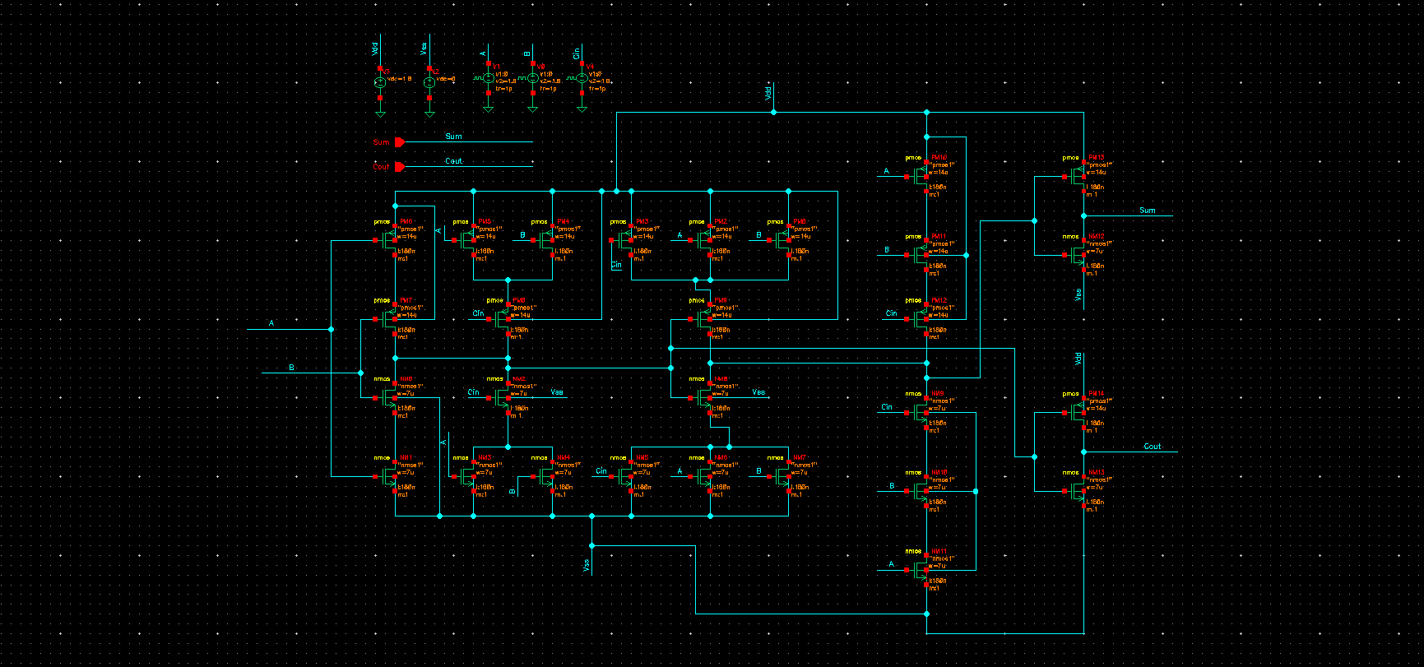
Full Adder Using Gates
S = A ⊕B⊕Cin;
Cout = (A*B) + (Cin*(A⊕B)).
A | B | C | S | C0
0 | 0 | 0 | 0 | 0
0 | 0 | 1 | 1 | 0
0 | 1 | 0 | 1 | 0
0 | 1 | 1 | 0 | 1
1 | 0 | 0 | 1 | 0
1 | 0 | 1 | 0 | 1
1 | 1 | 0 | 0 | 1
1 | 1 | 1 | 1 | 1
Transistors:
28 mosfets
Fig-11 : Schematic of Full Adder

Slide 16
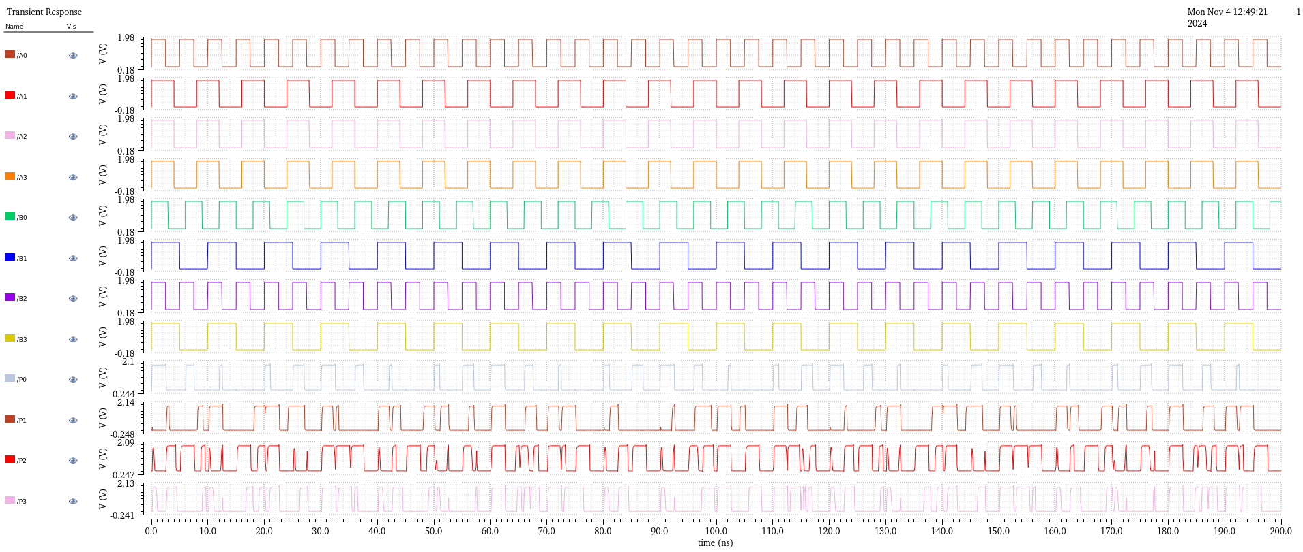
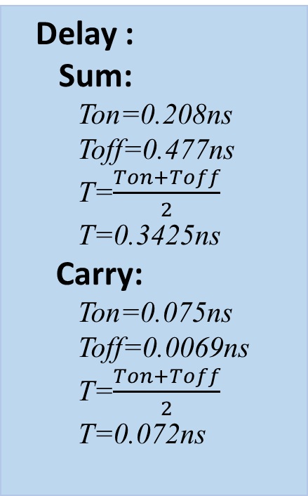
Output For Full Adder Using Gates:
Delay :
Sum:
Ton=0.208ns
Toff=0.477ns
T=$\frac{Ton+Toff}{2}$
T=0.3425ns
Carry:
Ton=0.075ns
Toff=0.0069ns
T=$\frac{Ton+Toff}{2}$
T=0.072ns
Fig-12 : Output of Full Adder

Slide 17
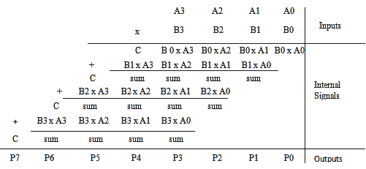
4 Bit Multiplication Algorithm

Slide 18
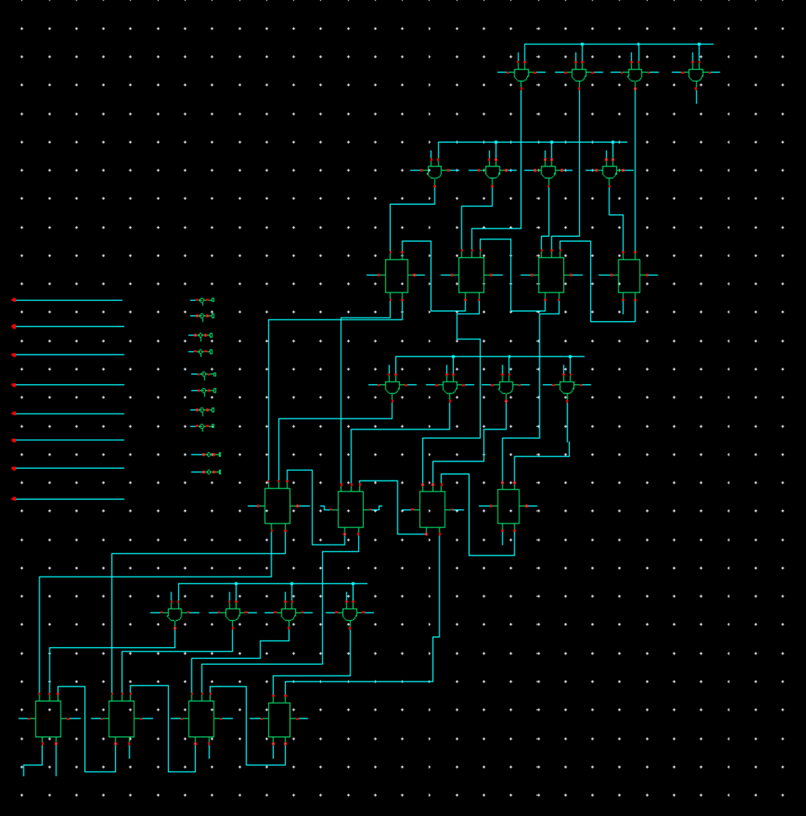

4 Bit Normal Multiplier:
Delay :
Ton=0.14ns
Toff=0.09ns
T=$\frac{Ton+Toff}{2}$
T=0.11ns
Transistors:
400 mosfets
Fig-6 : 4 Bit Normal Multiplier

Slide 19
Output For 4 Bit Multiplier :
Fig- 37: Output of 4 Bit Multiplier

Slide 20
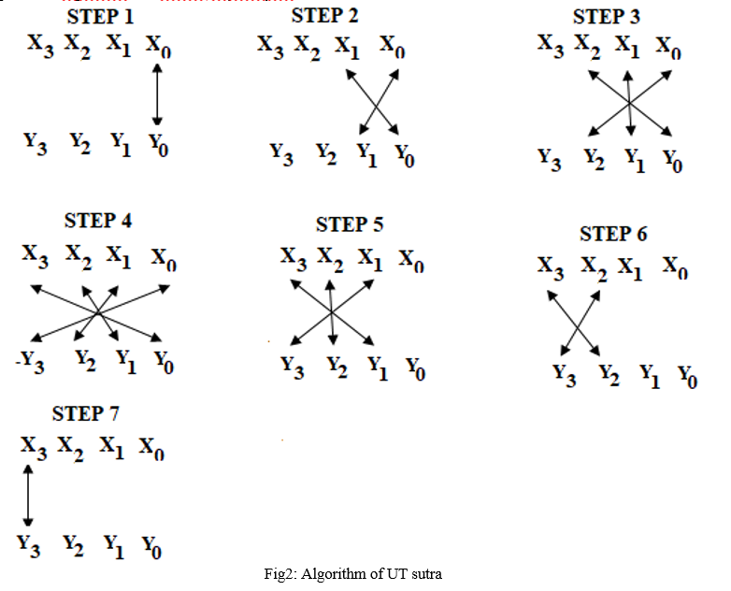
4 Bit Vedic Multiplication Algorithm

Slide 21
4 Bit Vedic Using Gates:
Fig-6 : 2 Bit Vedic Multiplier

Slide 22
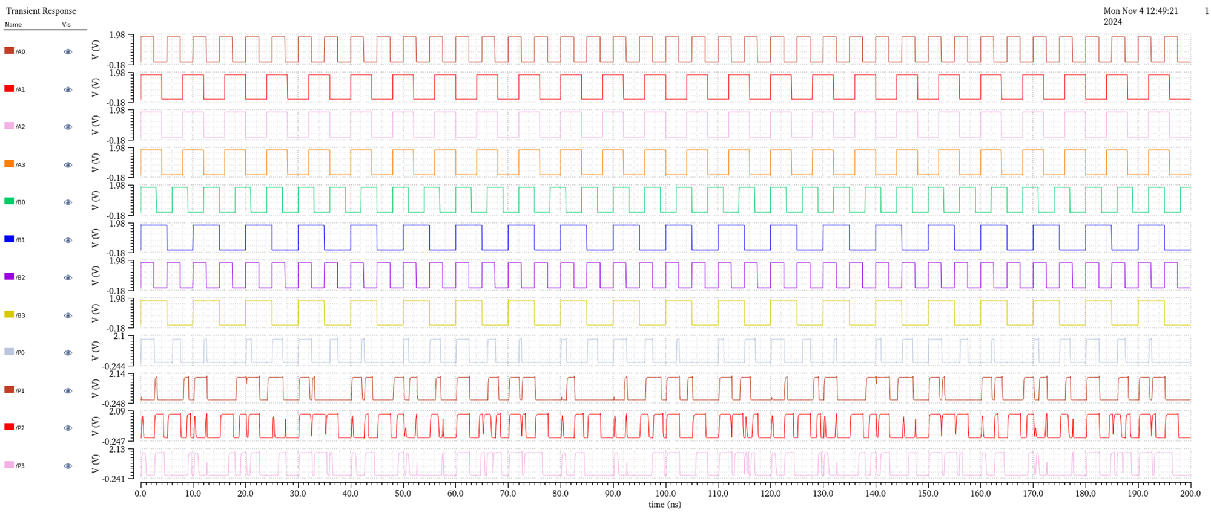
Output For 4 Bit Vedic Using Gates:
Fig- 37: Output of 8 Bit Multiplier

Slide 23
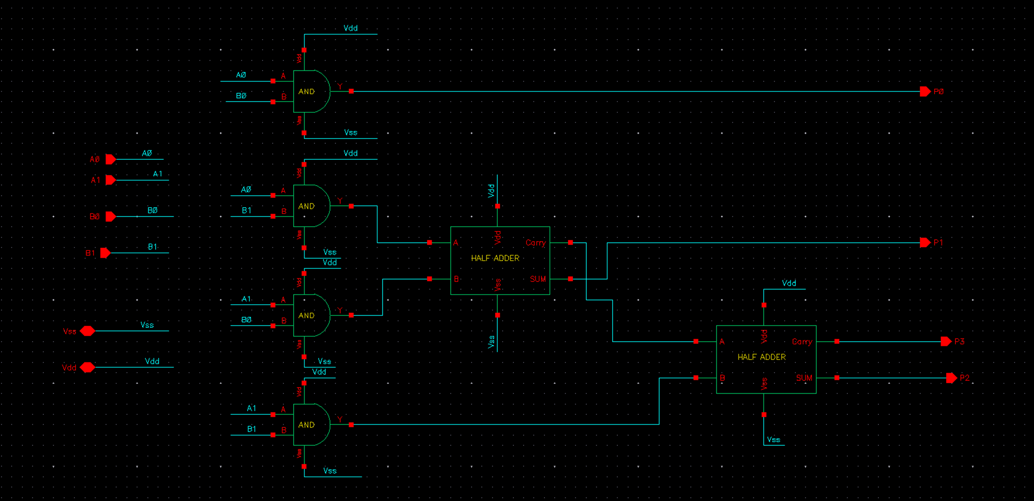
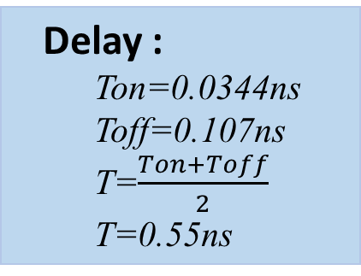
2 Bit Vedic Multiplier:
Delay :
Ton=0.0344ns
Toff=0.107ns
T=$\frac{Ton+Toff}{2}$
T=0.55ns
Transistors:
64 mosfets
Fig-6 : 2 Bit Vedic Multiplier

Slide 24
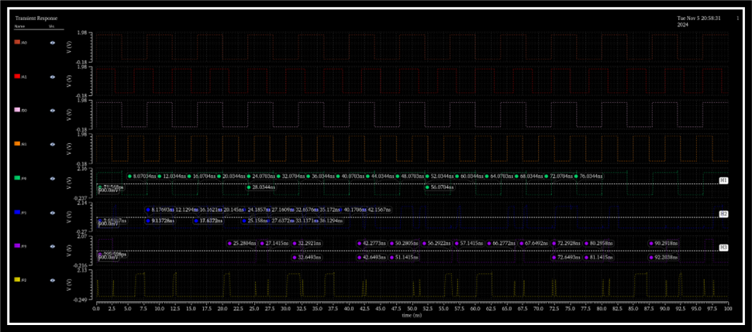
Output For 2 Bit Vedic Multiplier :
Fig- 37: Output of 2 Bit Multiplier

Slide 25
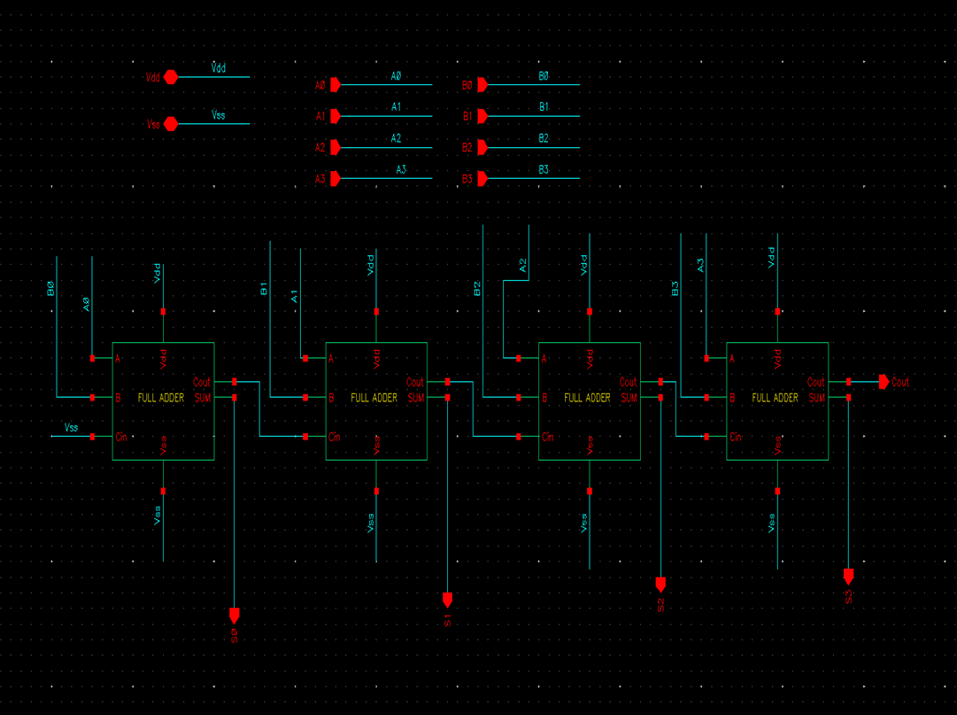
4 Bit RC Adder
Fig-15 : Schematic of Adder

Slide 26
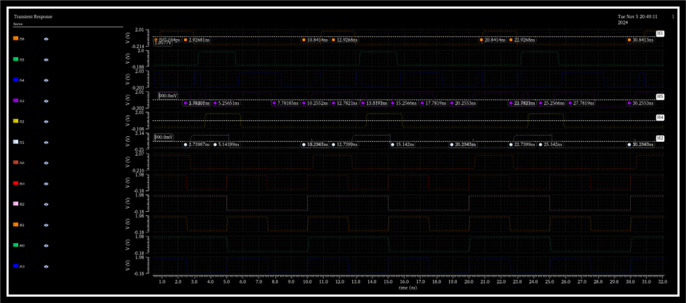
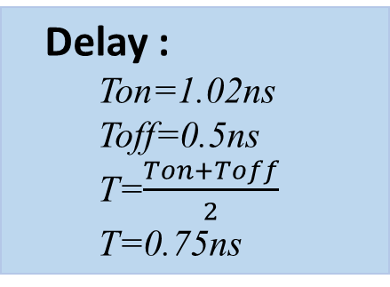
Output For 4 Bit RC Adder :
Delay :
Ton=1.02ns
Toff=0.5ns
T=$\frac{Ton+Toff}{2}$
T=0.75ns
Transistors:
112 mosfets
Fig-16 : Output of 4 Bit Adder

Slide 27
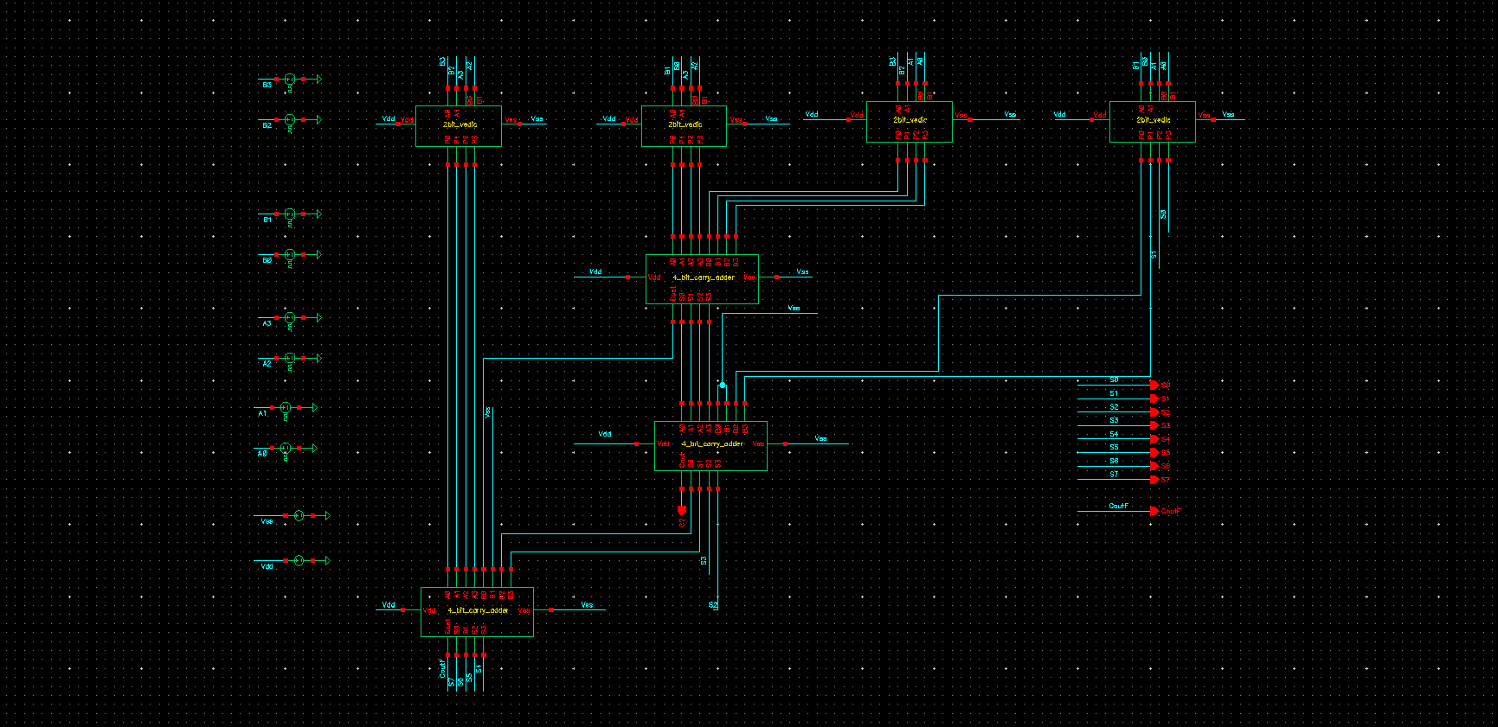
4 Bit Vedic Multiplier Using RCA
Fig-36 : Schematic of Multiplication

Slide 28
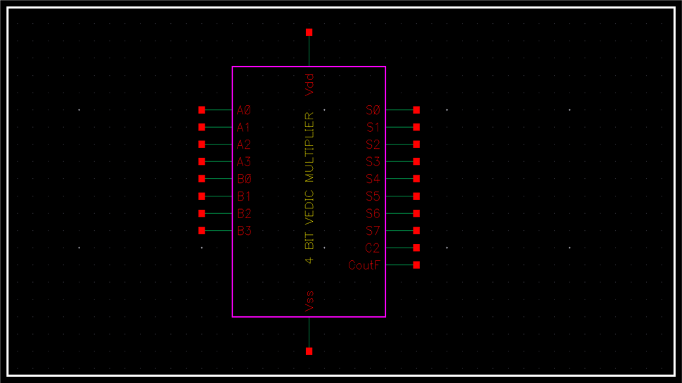
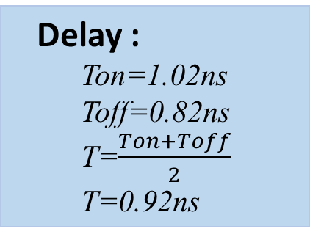
4 Bit Vedic Multiplier:
Delay :
Ton=1.02ns
Toff=0.82ns
T=$\frac{Ton+Toff}{2}$
T=0.92ns
Transistors:
592 mosfets
Fig-6 : Symbol of 4 Bit Vedic Multiplier

Slide 29
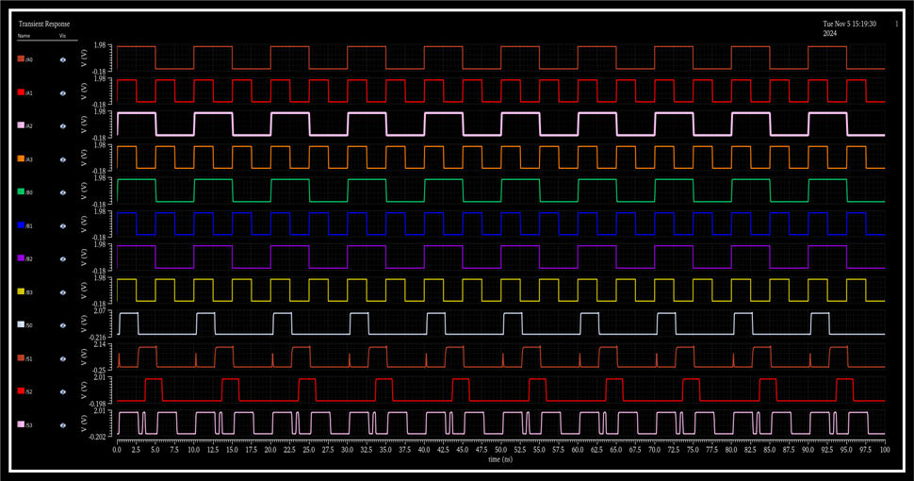
Output For 4 Bit Vedic Using RCA Part1 :
Fig- 37: Output of 8 Bit Multiplier

Slide 30
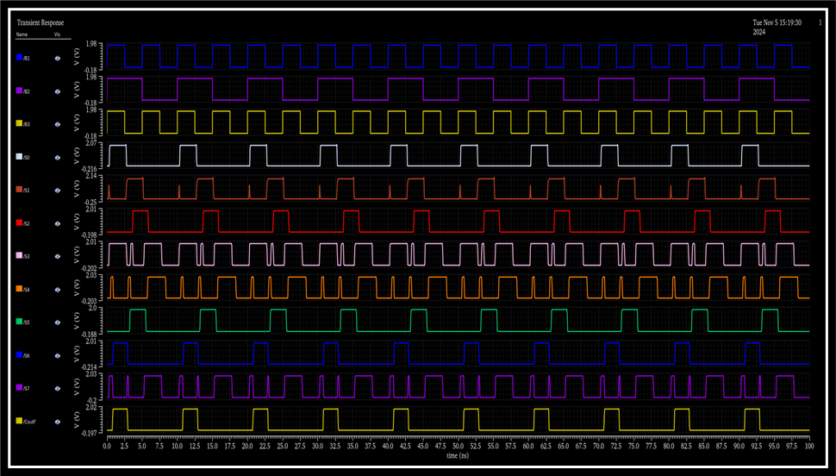
Output For 4 Bit Vedic Using RCA Part2 :
Fig- 37: Output of 8 Bit Multiplier

Slide 31
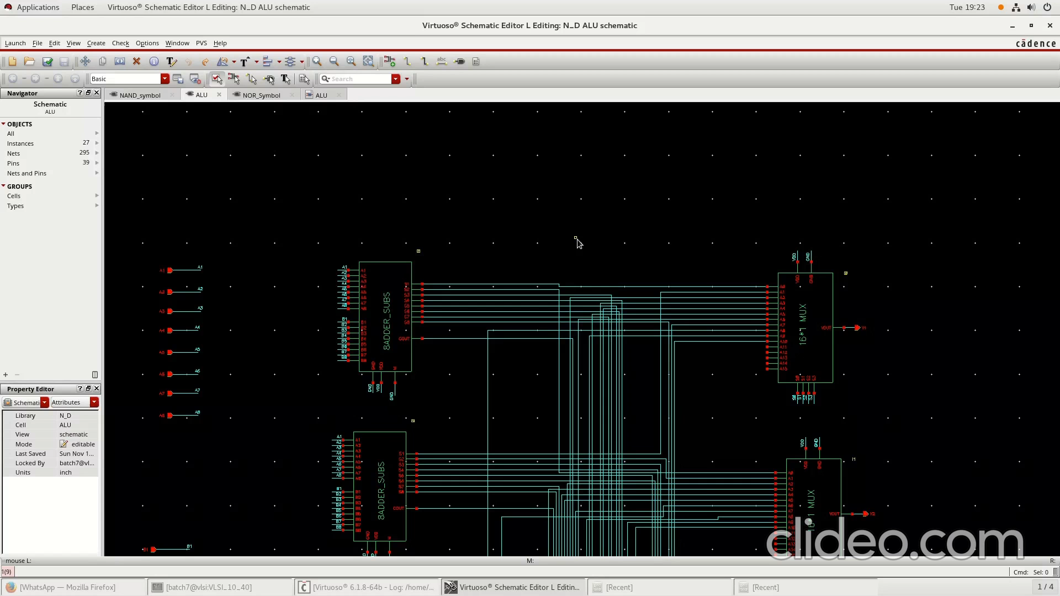
4 Bit Vedic Multiplier Demo Video :

Slide 32
COMPARISON
Parameter | Delay (ns) | Power (μW) | PDP (pJ)
Inverter | 0.03 | 13.3 | 0.399
NAND Gate | 0.24 | 18.72 | 4.492
AND Gate | 0.22 | 28.32 | 6.23
OR Gate | 0.27 | 32.18 | 8.688
XOR Gate | 0.32 | 42.53 | 4.67
Half Adder | 0.35 | 84.82 | 29.6
Full Adder | 0.65 | 220.41 | 143.19
2-bit vedic Multiplier | 0.5 | 140.58 | 70.25
4 -bit VedicType 1 | 1.43 | 1429 | 2043.47
4 -bit Vedic Type 2 | 0.92 | 1138 | 1046.96

Slide 33
APPLICATIONS
It is used in DSP applications
It is used for filters and Fourier Transform
It is also used in ALU
Embedded Systems
Communications system in QAM , OFDM
Machine Learning Matrix Multiplication
Control System Controller design

Slide 34
Thank You….!

